Slide 1
Addressing the third 90: Improving clinical outcomes and retention in care
Chloe Orkin
British HIV Association
Queen Mary University London
United Kingdom

Slide 2
Achieving 90-90-90
Professor Chloe Orkin,
Chair, British HIV Association
Queen Mary University London

Slide 3
Disclosures
Educational grants (HIV Unit): Merck Sharp & Dohme, Gilead Sciences, Janssen, ViiV Healthcare and Barts Charity
Honoraria and travel sponsorship for lectures and advisory board contributions
Member of the BHIVA Guidelines Subcommittee (2008−2017)
Chair and executive trustee of BHIVA
Not a patent holder or a shareholder
No disclosures for spouse or family members

Slide 4
Target is 30 million on treatment by 2020-UNAIDS
90-90-90
90-90-90
90-90-90
90-90-90
90-90-90

Slide 5
To do this we need Fast Track cities and countries
90-90-90
90-90-90
90-90-90
90-90-90
90-90-90

Slide 6
Progress toward achieving the third 90: Target 3: 90% of those on ART virally suppressed (n=35)
UNAIDS target 90%
Regional average 85%
Source: ECDC. Dublin Declaration monitoring 2018; validated unpublished data.
*Latest available data reported, ranging from 2014-2017.

Slide 7
Achieving success

Slide 8
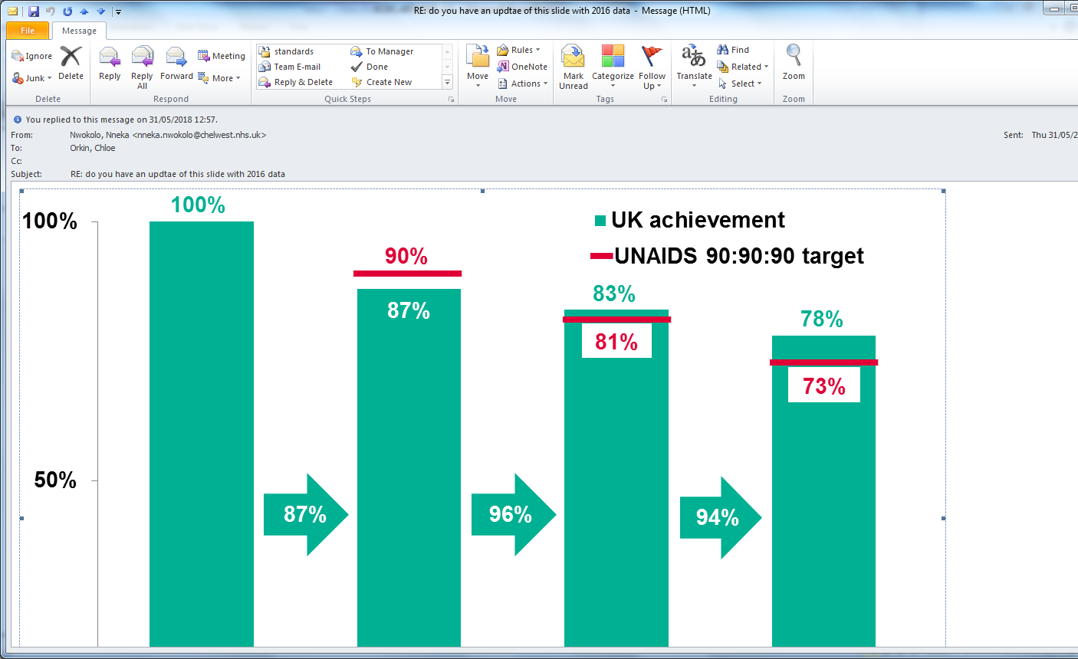
UK situation 2016
0%
People living with HIV
Virally
suppressed
People diagnosed
On treatment

Slide 9
London
90%
97%
97%
Diagnosed
On treatment
Undetectable*
*VL <200 c/mL.
Public Health England, 2016.

Slide 10
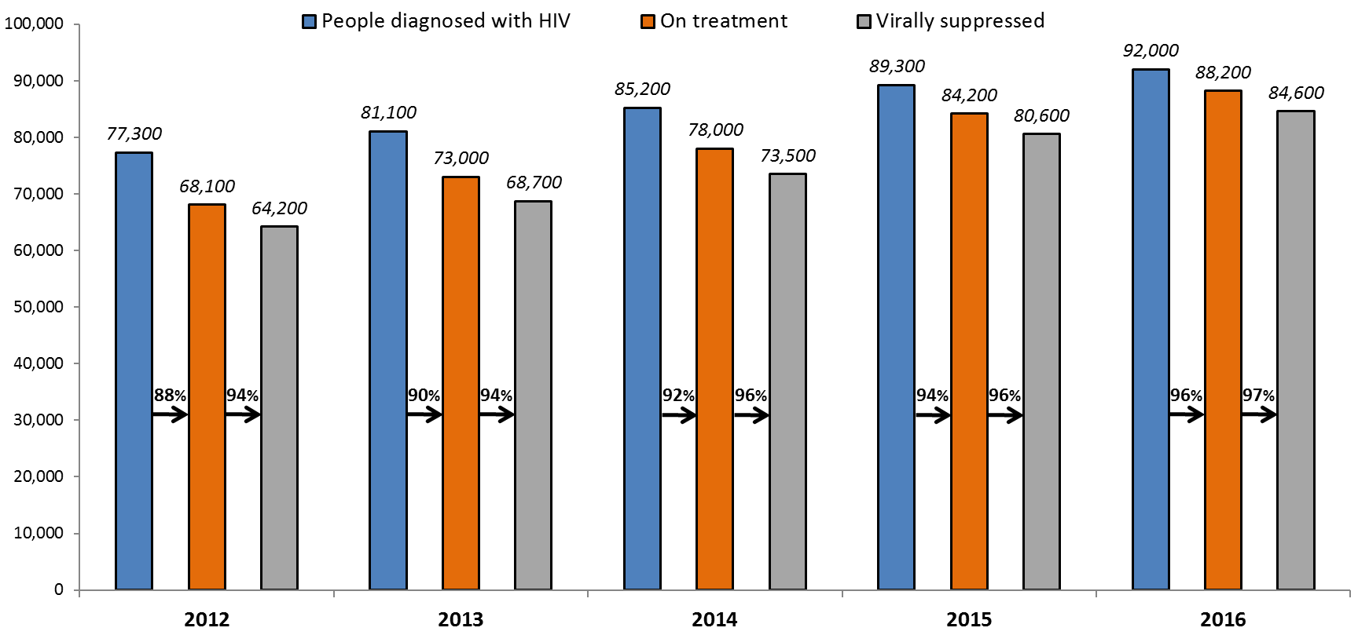
Cascade of Care
§All numbers have been rounded to the nearest 100.
‡ All numbers are from the National HIV and AIDS Reporting System (HARS) directly and have been adjusted for missing information.
* Virally suppressed was defined as having the latest reported viral load (VL) <200 copies/ml

Slide 11
Examining our journey to improve the cascade of care
§All numbers have been rounded to the nearest 100.
‡ All numbers are from the National HIV and AIDS Reporting System (HARS) directly and have been adjusted for missing information.
* Virally suppressed was defined as having the latest reported viral load (VL) <200 copies/ml

Slide 12
Assessing standards against guidelines
Epidemiology
Guidelines
Audit
Data from national surveillance on HIV epidemic
Auditable outcomes from guidelines
What are our services delivering?
What should they be like?
How can we improve ?

Slide 13
Improving care in the UK
BHIVA annual national audit
BHIVA Standards for HIV clinical care

Slide 14
Audit: evaluates a process not an outcome
Audit : a snapshot in time
Evaluates service delivery
All clinics participate
Not = national surveillance
Voluntary
Questions derived from guideline
Auditable outcomes or clinical issues
Data collection feasible for clinics

Slide 15
BHIVA National Audit timeline 2001-2018
2017
Mental health, substances
2018
Ageing
2015
Routine Monitoring
2016
Late diagnoses
2013
Partner notification
2014
Pregnancy
2011 Adherence
2012
Retention in Care
2009
HBV/HCV co-infection
2010
New diagnoses
2007
In-patient care
2008
ART Failure
2005
Mortality
2006
ART initiation re-audit
2003
Late Diagnoses
2004
Reasons for Switching ART
2001
CD4 count at start
2002
Time to starting ART

Slide 16
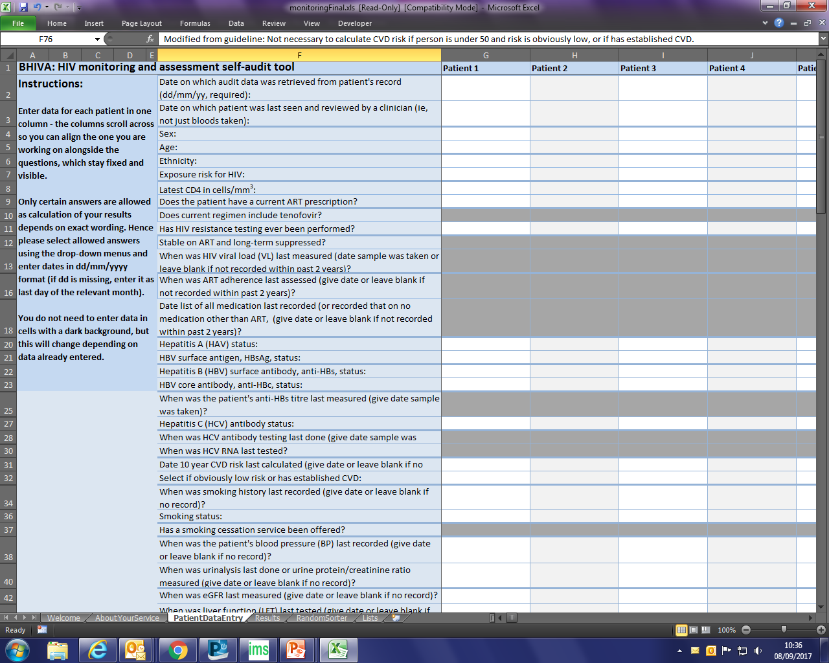
Tools: Self-audit spreadsheet tool (2015)
Notes:
This is the audit spreadhsheet tool that is sent by us to each clinic/ To be filled out on x number of patients

Slide 17
Tools: Online survey system (2017)
Notes:
New format this year, an online survey, explains the audit and works dynamically

Slide 18
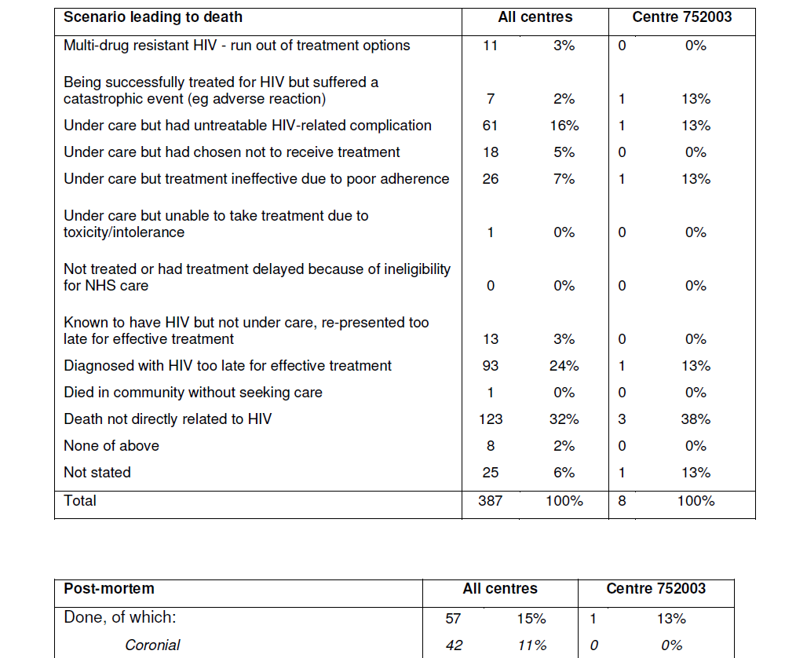
Confidential feedback to each clinic: compared with national figures

Slide 19
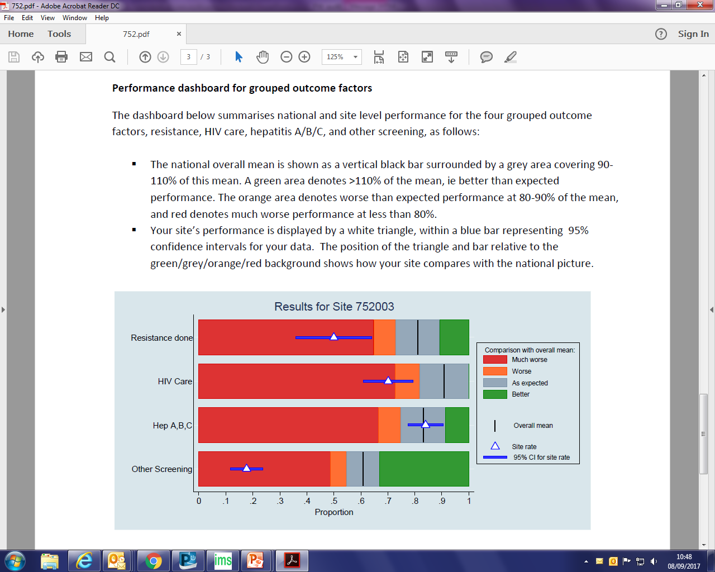
Feedback: dashboard for grouped outcomes

Slide 20
Audit Conclusions
Main Conclusion and recommendations from mortality audit:
Late diagnosis accounted for 24% of deaths overall and 35% of HIV related deaths
Causes not related to HIV accounted for 32% of deaths

Slide 21
National Dissemination
National presentation
Given by doctor in training
Embedding standard of care approach

Slide 22
Going beyond the 3rd 90 –achieving the 4th 90
Enhancing engagement with care
Avoiding side effects and comorbidity
90%
97%
97%
?
Diagnosed
On treatment
Undetectable
4th 90¹
1. Lazarus JV, et al. BMC Med 2016;14:94.

Slide 23
BHIVA Standards for PLWHIV

Slide 24
Foster Engagement
Melbourne fast-track City
Notes:
Feed into guidelines
Feed into commissioning for health
Feed into national reporting requirements

Slide 25
Questions?
@britishhivassoc
@britishhivassoc
British HIV Association

